Slide 1
An Advanced Real Plus Minus for Soccer Kushal Shah, James Hyman, and Dominic Samangy Syracuse University Soccer Analytics Club

Slide 2
Table of Contents
1. Introduction
2. Data Collection
3. Ridge Regressions
4. Weighted Sum of Ridge Coefficients
5. Findings
6. Applications and Usage
7. Improvements, Limitations, and Conclusion

Slide 3
Introduction
Soccer has always had a lack of advanced metrics compared to other sports in North America
We decided to apply the Real Plus Minus concept from Basketball and Hockey to Soccer
The reason why ours is Advanced is because we include metrics in addition to Goals
Typically, RPM only includes points and goals.
We used stint data and a ridge regression to calculate this metric.

Slide 4
Data Collection

Slide 5
Data
We scraped stint and lineup data for the 2019-2020 Premier League season
Each stint is defined as a period when the 22 players on the field are the same
Substitutions and Red Cards result in stint changes.
The stint data keeps track of which players were on the field for the home and away team.
1 represents a home team player, -1 represents an away team player

Slide 6
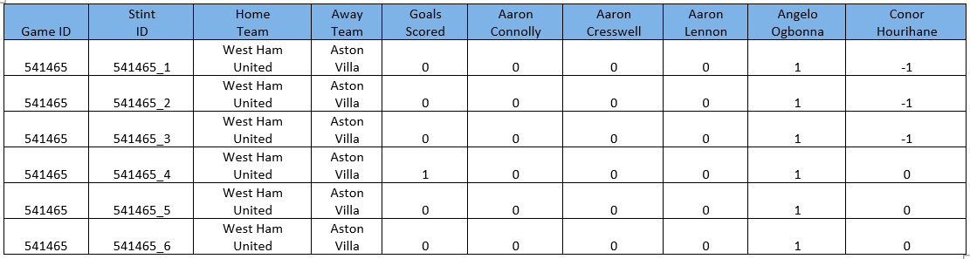
Data
The stint data was coupled with the count of different events for each stint
Example: Goals, Shots on Target, etc.
Below is a snippet of what our data would look like for Goals:

Slide 7
Ridge Regressions

Slide 8
Ridge Regressions
For each recorded event we ran a Ridge Regression
The ridge regression will add “bias” to players who are playing against better players, hence their contributions during that game will be even more noteworthy.
This accounts for the level of talent on the field, accurately measuring players contribution
The ridges were run on both the offensive and defensive side
This allowed us to create an Advanced Attacking and Defending RPM

Slide 9
Ridge Regressions
Each ridge regression provided a coefficient for the respective statistic
Kevin De Bruyne’s Shots on Target coefficient = 0.30951
This implies that there are 0.30951 more Shots on Target when De Bruyne is on the field
We ran a ridge regression for each of the following metrics:
Goals, Penalties, Shots on Target, Shots off Target, Counter Attacks, Key Passes, Red Cards, Yellow Cards, Corners, Free Kicks in the Attacking Half

Slide 10
Weighted Sum of Ridge Coefficients

Slide 11
Weighted Sum
We used all the coefficients to calculate a weighted sum which provided a holistic measurement of a player’s impact.
This weighted concept values all contributions, and not only goals
Each event was weighted by their “goal value”
Goal Value being how likely that event is to result in a goal
For Example: xG for Penalties is 0.76, hence we used the weight for penalties as 0.76.

Slide 12
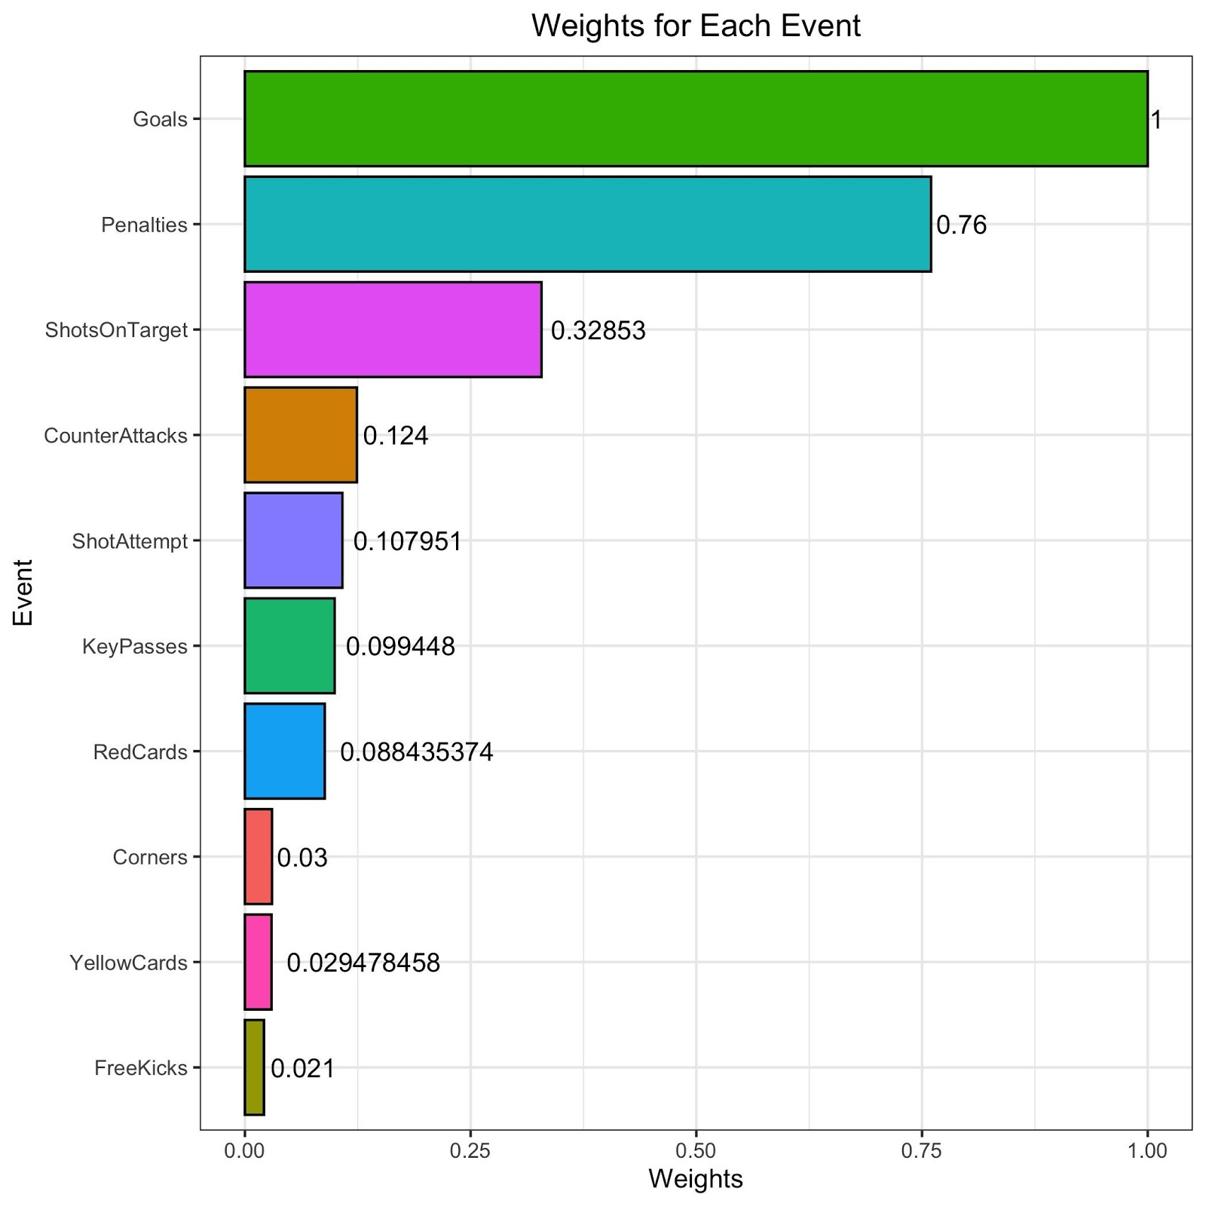
Weights
The weights were reversed for each event on defense, so giving up a penalty has a weight of -0.76. Similarly goals scored has a weight of 1 while goals allowed has a weight of -1.
This results in a Defensive Advanced RPM for a player being scaled in a manner where a greater value is preferred.
The overall Advanced RPM is simply the Advanced Attacking RPM + Advanced Defending RPM

Slide 13
Findings and Results

Slide 14
Attacking vs Midfield vs Defending
Soccer does not require every player to be heavily involved on the both sides of the field, attacking and defending. Hence:
Attacking players should value their Attacking RPM more
Defensive players should value their Defensive RPM more
Since Midfielders contribute to both attack and defense, their overall Advanced RPM is a better metric for that position grouping.

Slide 15
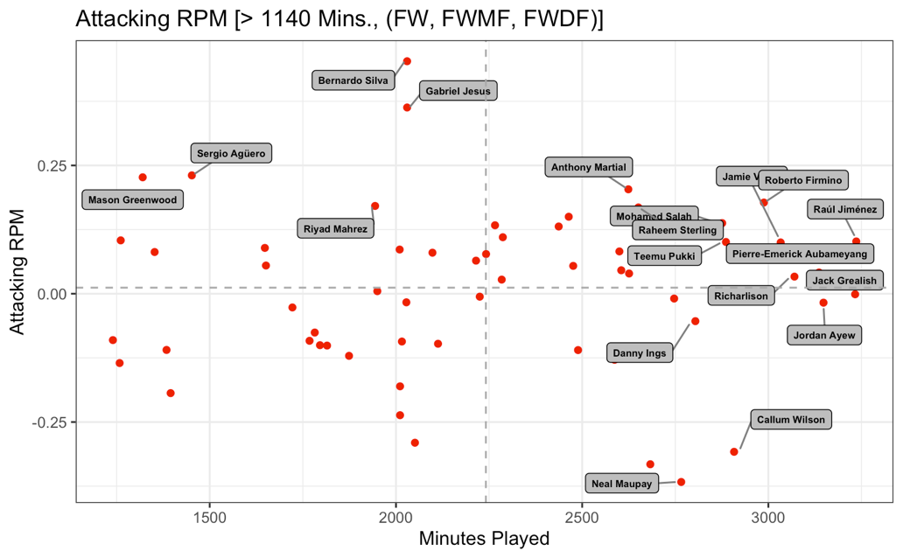
Advanced Attacking RPM
Based on our metric, here are the top attackers from the 2019-20 season
Vardy, Firmino, Martial, and Sterling stand out amongst those with >2500 minutes played.
With less minutes played, Silva and Jesus score the highest, but figure may be inflated.
These players named justify accuracy and validity of the model to a degree. This doesn’t mean it’s perfect. Should be a supplement to eye test and other reports.

Slide 16
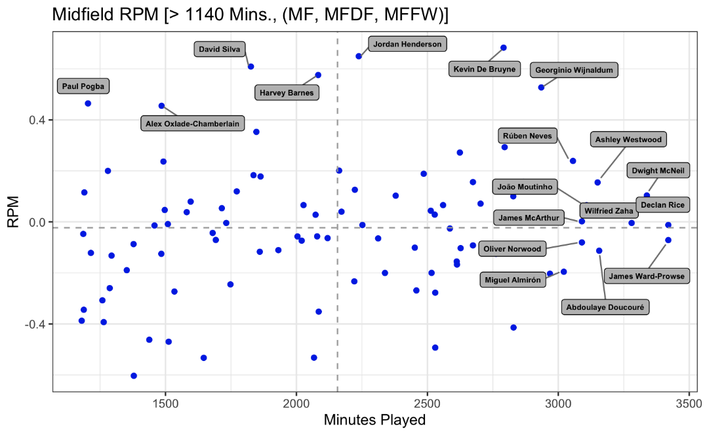
Advanced RPM
Based on our metric, here are the top midfielder from the 2019-20 season
De Bruyne, Wijnaldum, and Ruben Neves stand out
With less minutes played, Henderson, Barnes, and Silva score the highest, but figure may be inflated
Dr Bruyne being one of the best Midfielder helps further validate the metric as he is widely considered as one of the best in the world

Slide 17
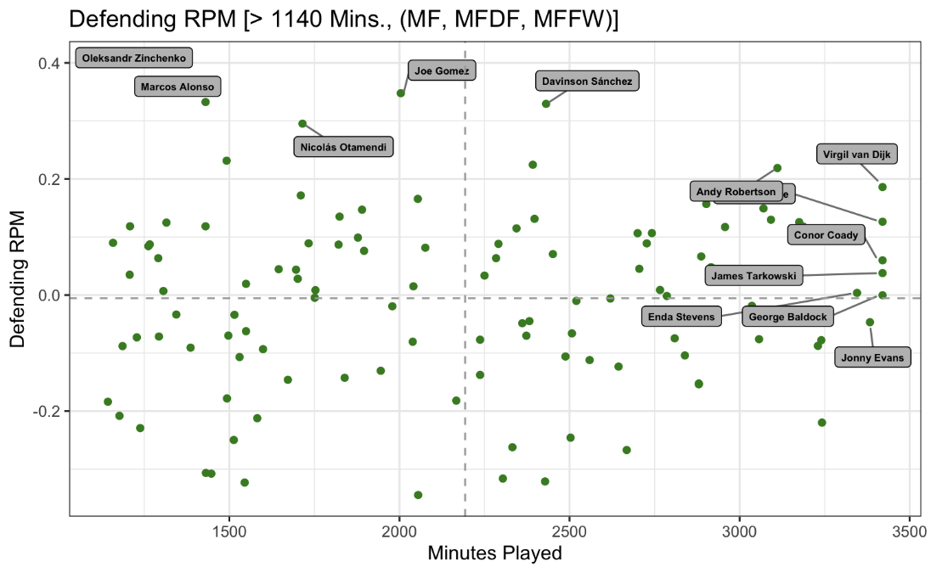
Advanced Defending RPM
Based on our metric, here are the top defenders from the 2019-20 season
Van Dijk, Robertson, and Sanchez stand out amongst those with the most minutes played.
With less minutes played, Gomez, Otamendi, and Alonso core the highest, but as mentioned earlier, this figure may be inflated.

Slide 18
Applications and Usage

Slide 19
Applications and Usage
Lineup and Squad Selection
Managers can tailor lineups based on the game plan
Transfer Targets
Teams can identify undervalued players
This especially helps smaller clubs who can spend less for better players
Youth Talent
Determining which youth level players to acquire and develop.

Slide 20
Improvements, Limitations and Conclusion

Slide 21
Limitations and Improvements
The weights applied to each event could be fine tuned to be more accurate
A more accurate weight results in the RPM being more accurate
The difference in play style between Goalkeepers versus other players limits the metric when analyzing Goalkeepers

Slide 22
Conclusion
We believe our metric has very promising results and can be an effective tool to analyze players
While this shouldn’t be used as an end all argument when analyzing players, we believe it can provide insight in a player’s ability
Moreover, this Advanced RPM concept can be applied to different sports as well, providing a more accurate measure of a player’s impact

Slide 23
Questions? Thank you to the Midwest Sport Analytics Conference and the Audience

